Slide 1
Security
Jakub Scholz

Slide 2
Security
Encryption between clients and brokers and between brokers
Using SSL
Authentication of clients (and brokers) connecting to brokers
Using SSL (mutual authentication, mTLS)
Using SASL (with PLAIN, Kerberos or SCRAM-SHA as mechanisms)
Authorization of read/writes operation by clients
ACLs on resources such as topics
Authenticated “principal” for configuring ACLs
Pluggable
Additionally in AMQ Streams
Authentication using OAuth
Primary focus on Keycloak / RH-SSO
Should work with other OAuth servers as well
Authorization using Keycloak Authorization Services
Works only with Keycloak / RH-SSO

Slide 3
Security
ZooKeeper
TLS encryption of Zookeeper connections in Kafka broker supported since Kafka 2.5
Supports SASL for authentication (Kerberos, DIGEST-MD5)
ACLs can be used to limit write access
On RHEL
Everything is configured by the user
Supports authentication using Kerberos, SASL DIGEST-MD5, TLS Client Authentication (mTLS)
On OCP
Zookeeper is protected by TLS encryption and TLS authentication out of the box
ZooKeeper is not accessible to users, only to AMQ Streams components

Slide 4
Configuring ZooKeeper
Authentication
By default, ZooKeeper does not use any form of authentication and allows anonymous connections.
Support Java Authentication and Authorization Service (JAAS) which can be used to set up authentication using Simple Authentication and Security Layer (SASL). ZooKeeper supports authentication using the DIGEST-MD5 SASL mechanism with locally stored credentials.
Authentication with SASL
JAAS is configured using a separate configuration file. It is recommended to place the JAAS configuration file in the same directory as the ZooKeeper configuration (/opt/kafka/config/). The recommended file name is zookeeper-jaas.conf. When using a ZooKeeper cluster with multiple nodes, the JAAS configuration file has to be created on all cluster nodes.
Use the KAFKA_OPTS environment variable to pass the JAAS configuration file to the ZooKeeper server as a Java property:
export KAFKA_OPTS="-Djava.security.auth.login.config=/opt/kafka/config/zookeeper-jaas.conf"
Notes:
The Java Authentication and Authorization Service (JAAS)

Slide 5
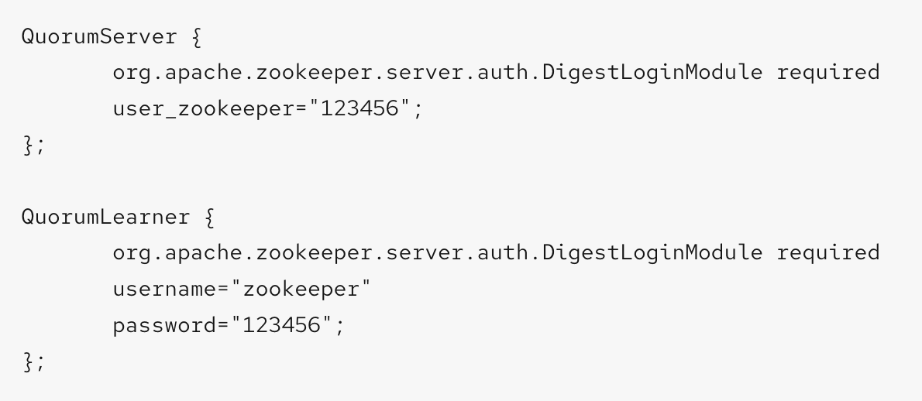
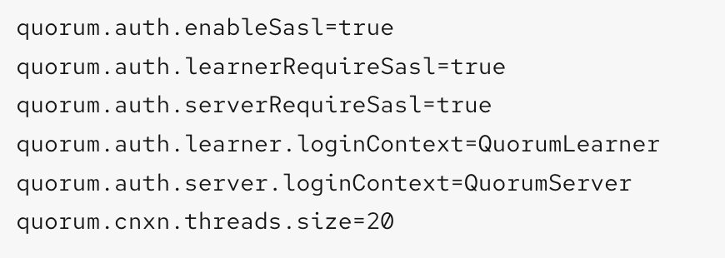
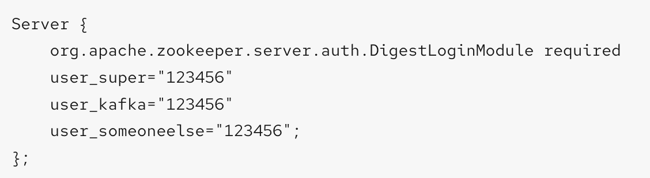
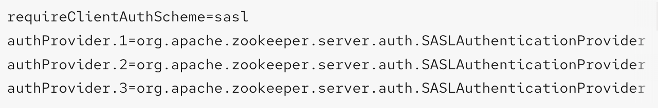
Configuring ZooKeeper
Authentication with SASL (cont.)
Server-to-Server (communication between ZooKeeper instances)
Client-to-Server (communication between Kafka and ZooKeeper)
Server-to-Server authentication example
Enable the server-to-server authentication in the regular ZooKeeper configuration file
Client-to-Server authentication example
Enable the client-to-server authentication in the ZooKeeper configuration file,
You must add the authProvider.<ID> property for every server that is part of the ZooKeeper cluster.

Slide 6
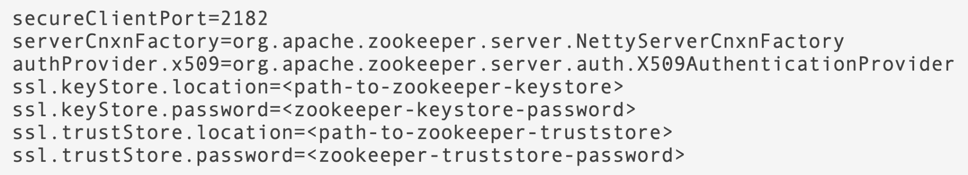
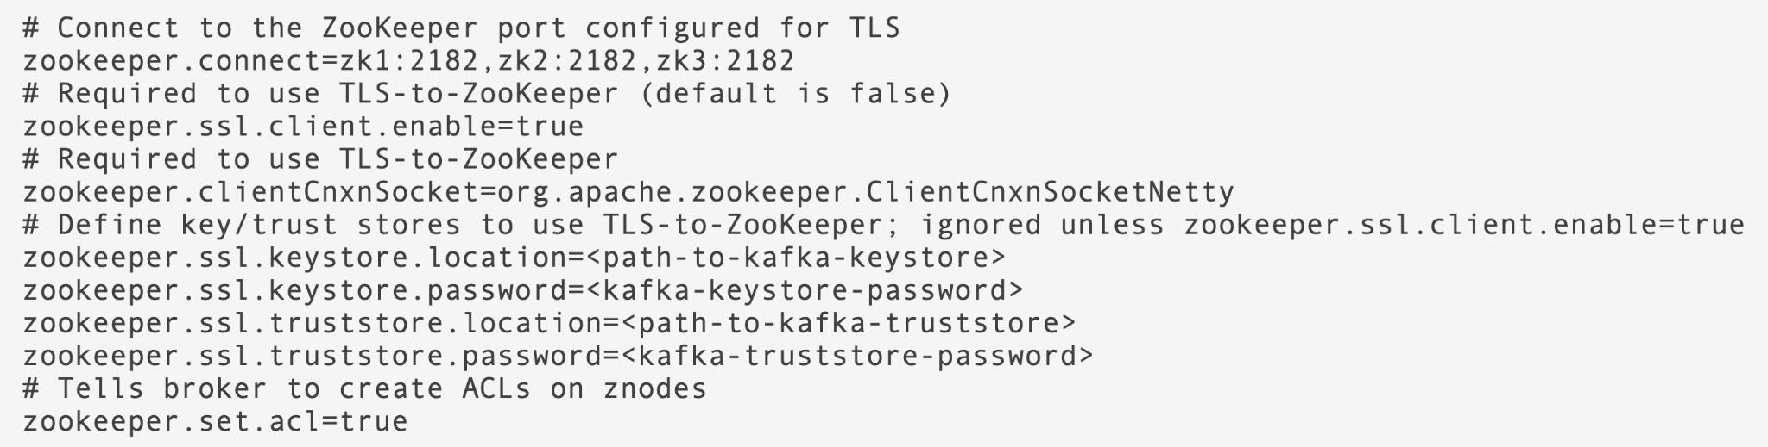
Configuring ZooKeeper
TLS
To enable mTLS authentication for ZooKeeper you must configure both ZooKeeper and Kafka. The following example shows a ZooKeeper configuration that enables mTLS authentication:
Kafka configuration that connects to ZooKeeper using mTLS authentication

Slide 7
Security
Kafka
Authentication: SASL PLAIN, SCRAM-SHA, OAUTHBEARER, Kerberos and mTLS
Authorization
Simple ACL Authorizer
OAuth authorization based on Keycloak Authorization services
Encryption
TLS supported for encryption and authentication
TLSv1.3 supported since Kafka 2.5.0 / AMQ Streams 1.5.0 (on Java 11 only)
Kafka Connect, Mirror Maker, Clients
Support everything what is supported by the broker

Slide 8
SASL PLAIN
Username and password based authentication
Passwords are transferred over the network
Do not use on unencrypted connections
Users and passwords are configured in local JAAS configuration file
They are stored unencrypted in the file
The file needs to be available / distributed to all brokers

Slide 9
SASL SCRAM-SHA
Username and password based authentication
Two SASL mechanisms: SCRAM-SHA-256 and SCRAM-SHA-512
Hashed passwords are used for authentication
Stored in ZooKeeper
Transferred over network in scrambled way

Slide 10
SASL GSSAPI
AMQ Streams supports the use of the Kerberos (GSSAPI) authentication protocol for secure single sign-on access to your Kafka cluster.
GSSAPI is an API wrapper for Kerberos functionality, insulating applications from underlying implementation changes.
Kerberos is a network authentication system that allows clients and servers to authenticate to each other by using symmetric encryption and a trusted third party, the Kerberos Key Distribution Centre (KDC).
Prerequisites
Access to a Kerberos server
A Kerberos client on each Kafka broker host
Support both server and client

Slide 11
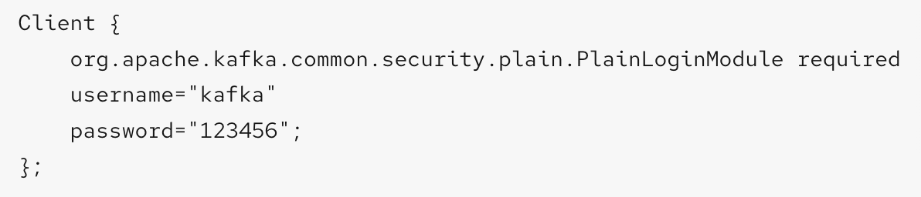
Configuring Kafka
zookeeper authentication
Enabling SASL DIGEST-MD5 authentication
On all Kafka broker nodes, create or edit the /opt/kafka/config/jaas.conf JAAS configuration file and add the following context:
use the KAFKA_OPTS environment variable.
export KAFKA_OPTS="-Djava.security.auth.login.config=/opt/kafka/config/jaas.conf";
Enable zookeeper access control list (ACL) in the config/server.properties Kafka configuration file.
zookeeper.set.acl=true

Slide 12
Configuring Kafka
Encryption and Authentication :
Encryption and authentication in Kafka brokers is configured per listener.
Each listener in the Kafka broker is configured with its own security protocol. The configuration property listener.security.protocol.map defines which listener uses which security protocol. It maps each listener name to its security protocol. Supported security protocols are:
PLAINTEXT : Listener without any encryption or authentication.
SSL : Listener using TLS encryption and, optionally, authentication using TLS client certificates.
SASL_PLAINTEXT : Listener without encryption but with SASL-based authentication.
SASL_SSL : Listener with TLS-based encryption and SASL-based authentication.
listeners=INT1://:9092,INT2://:9093,REPLICATION://:9094
listener.security.protocol.map=INT1:SASL_PLAINTEXT,INT2:SASL_SSL,REPLICATION:SSL

Slide 13
Configuring Kafka
TLS Encryption :
Kafka supports TLS for encrypting communication with Kafka clients.
Generate TLS certificates for all Kafka brokers in your cluster. The certificates should have their advertised and bootstrap addresses in their Common Name or Subject Alternative Name.
Edit the /opt/kafka/config/server.properties Kafka configuration file on all cluster nodes for the following:
Change the listener.security.protocol.map field to specify the SSL protocol for the listener where you want to use TLS encryption.
Set the ssl.keystore.location option to the path to the JKS keystore with the broker certificate.
Set the ssl.keystore.password option to the password you used to protect the keystore.
For example:
listeners=UNENCRYPTED://:9092,ENCRYPTED://:9093,REPLICATION://:9094
listener.security.protocol.map=UNENCRYPTED:PLAINTEXT,ENCRYPTED:SSL,REPLICATION:PLAINTEXT
ssl.keystore.location=/path/to/keystore/server-1.jks
ssl.keystore.password=123456

Slide 14
Configuring Kafka
Enabling TLS client authentication
Prepare a JKS truststore containing the public key of the certification authority used to sign the user certificates.
Edit the /opt/kafka/config/server.properties Kafka configuration file on all cluster nodes for the following:
Set the ssl.truststore.location option to the path to the JKS truststore with the certification authority of the user certificates.
Set the ssl.truststore.password option to the password you used to protect the truststore.
Set the ssl.client.auth option to required.
For example:
ssl.truststore.location=/path/to/truststore.jks
ssl.truststore.password=123456
ssl.client.auth=required

Slide 15
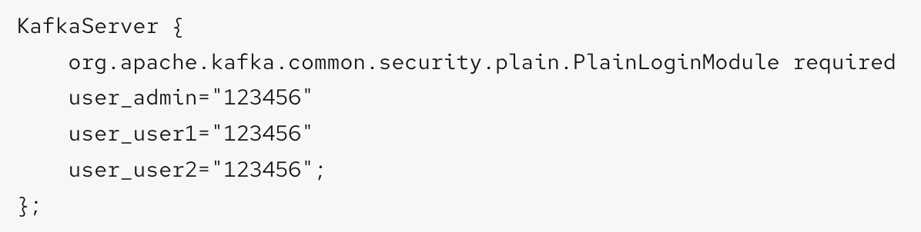
Configuring Kafka
Enabling SASL authentication :
Edit or create the /opt/kafka/config/jaas.conf JAAS configuration file. This file should contain all your users and their passwords. Make sure this file is the same on all Kafka brokers.
Edit the /opt/kafka/config/server.properties Kafka configuration file on all cluster nodes for the following:
Change the listener.security.protocol.map field to specify the SASL_PLAINTEXT or SASL_SSL protocol for the listener where you want to use SASL PLAIN authentication.
Set the sasl.enabled.mechanisms option to PLAIN.
listeners=INSECURE://:9092,AUTHENTICATED://:9093,REPLICATION://:9094
listener.security.protocol.map=INSECURE:PLAINTEXT,AUTHENTICATED:SASL_PLAINTEXT,REPLICATION:PLAINTEXT
sasl.enabled.mechanisms=PLAIN
using the KAFKA_OPTS environment variable to pass the JAAS configuration to Kafka brokers.
export KAFKA_OPTS="-Djava.security.auth.login.config=/opt/kafka/config/jaas.conf"

Slide 16
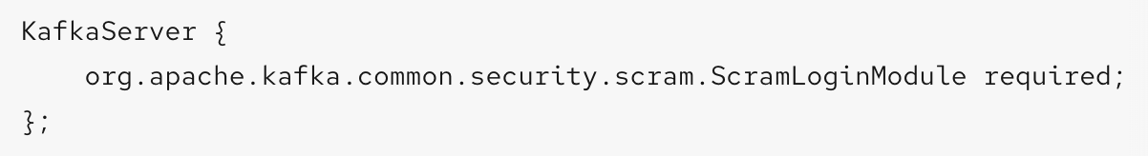
Configuring Kafka
Enabling SASL SCRAM authentication :
Edit or create the /opt/kafka/config/jaas.conf JAAS configuration file. Enable the ScramLoginModule for the KafkaServer context. Make sure this file is the same on all Kafka brokers.
Edit the /opt/kafka/config/server.properties Kafka configuration file on all cluster nodes for the following:
Change the listener.security.protocol.map field to specify the SASL_PLAINTEXT or SASL_SSL protocol for the listener where you want to use SASL SCRAM authentication.
Set the sasl.enabled.mechanisms option to SCRAM-SHA-256 or SCRAM-SHA-512
listeners=INSECURE://:9092,AUTHENTICATED://:9093,REPLICATION://:9094
listener.security.protocol.map=INSECURE:PLAINTEXT,AUTHENTICATED:SASL_PLAINTEXT,REPLICATION:PLAINTEXT
sasl.enabled.mechanisms=SCRAM-SHA-512
using the KAFKA_OPTS environment variable to pass the JAAS configuration to Kafka brokers.
export KAFKA_OPTS="-Djava.security.auth.login.config=/opt/kafka/config/jaas.conf"

Slide 17
Configuring Kafka
Enabling SASL SCRAM authentication :
Adding SASL SCRAM users
bin/kafka-configs.sh --bootstrap-server localhost:9092 --alter --add-config 'SCRAM-SHA-512=[password=123456]' --entity-type users --entity-name user1
Deleting SASL SCRAM users
/opt/kafka/bin/kafka-configs.sh --bootstrap-server localhost:9092 --alter --delete-config 'SCRAM-SHA-512' --entity-type users --entity-name user1

Slide 18
OAuth authentication
Uses OAuth access tokens for authentication
Clients gets the token from the OAuth server
Passes it to broker using the SASL OAUTHBEARER mechanisms
Broker verifies it and authenticates the client
Different from OAuth in web-apps
No human involvement needed
No browsers
Can be used to federate to other LDAP or AD through Keycloak / RH-SSO

Slide 19




OAuth authentication
Kafka Protocol
Get access token
Verify access token

Slide 20
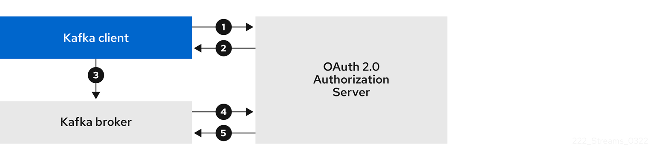
Configuring Kafka
Using OAuth 2.0 token-based authentication :
AMQ Streams supports the use of OAuth 2.0 authentication using the OAUTHBEARER and PLAIN mechanisms. Both mechanisms allow Kafka clients to establish authenticated sessions with Kafka brokers.
Example Flow
The Kafka client requests an access token from the authorization server using a client ID and secret, and optionally a refresh token.
The authorization server generates a new access token.
The Kafka client authenticates with the Kafka broker using the SASL OAUTHBEARER mechanism to pass the access token.
The Kafka broker validates the access token by calling a token introspection endpoint on the authorization server using its own client ID and secret.
A Kafka client session is established if the token is valid.
More Detail : https://access.redhat.com/documentation/en-us/red_hat_amq_streams/2.2/html/using_amq_streams_on_rhel/assembly-configuring-amq-streams-str#assembly-oauth-authentication_str

Slide 21
Simple Authorizer
ACL (Access Control List) - have to be maintained by administration and onboard new users.
Part of Apache Kafka
ACL rules are stored in ZooKeeper
Each rule consists of 4 pieces:
Type
Resource
Resource name
Operation

Slide 22
Simple Authorizer
Type can be allow or deny
On OCP, the User Operator supports only allow rules and everything is denied by default
Resource
One of topic, group, cluster
Resource name
As a literal
Or as a prefix
* can be used for all
Operation
Describes the action which can be taken
Common operations such as Read, Write, Delete, Alter, Describe, All, etc.
Notes:
, transactionalId

Slide 23
Simple Authorizer
Producing to topics
‘ResourcePattern(resourceType=TOPIC, name=test, patternType=LITERAL)’:
(principal=User:alice, host=*, operation=WRITE, permissionType=ALLOW)
(principal=User:alice, host=*, operation=CREATE, permissionType=ALLOW)
Consuming from Topics
`ResourcePattern(resourceType=TOPIC, name=test, patternType=LITERAL)`:
(principal=User:alice, host=*, operation=WRITE, permissionType=ALLOW)
Describing consumer groups
`ResourcePattern(resourceType=GROUP, name=bob-group, patternType=LITERAL)`:
(principal=User:bob, host=*, operation=READ, permissionType=ALLOW)
(principal=User:charlie, host=*, operation=READ, permissionType=ALLOW)

Slide 24
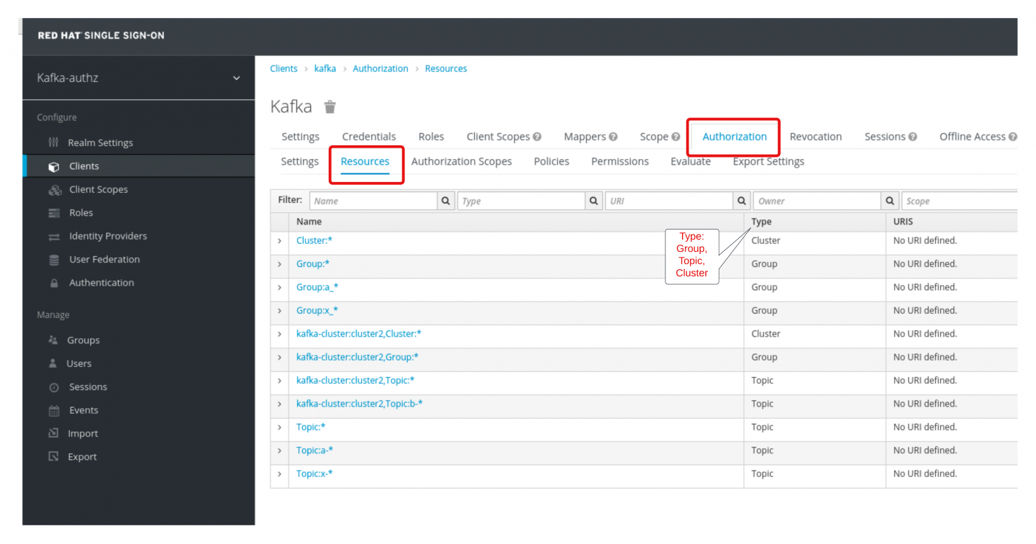
OAuth authorizer
Uses Keycloak Authorization services
Works only with Keycloak / RH-SSO
ACL rules are managed in Keycloak
Same types of operations and resources as with Simple Authorizer
Notes:
https://developers.redhat.com/articles/2022/05/04/use-red-hats-sso-manage-kafka-broker-authorization

Slide 25
Thank you

